Slide 1
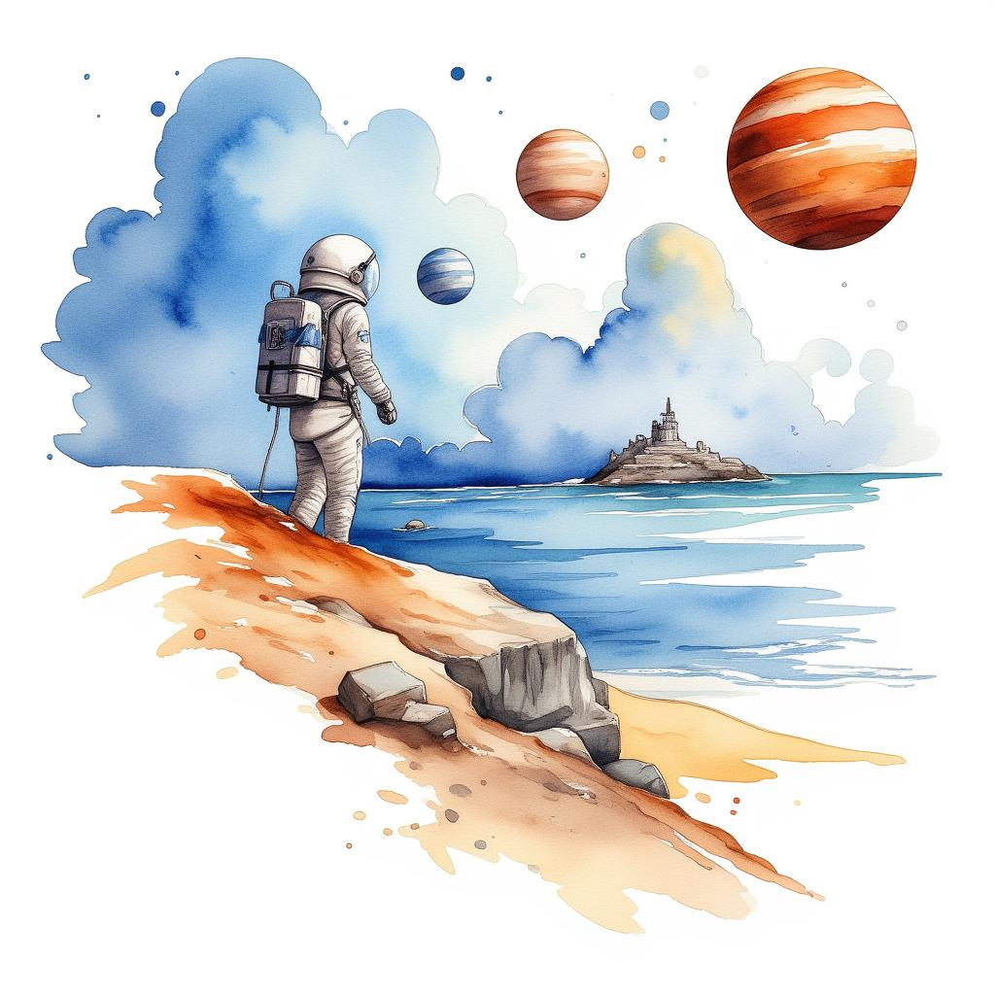
Mustafa's Trip to Mars
Written by Abubakar Abid

Slide 2
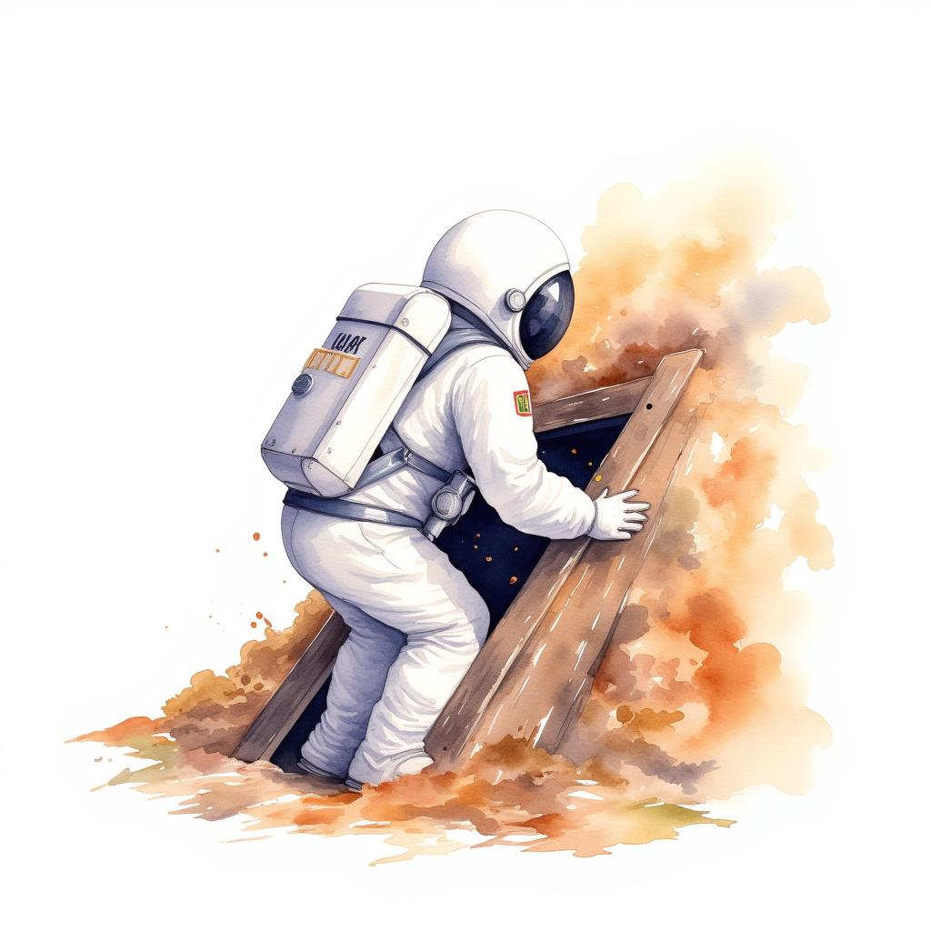
One day, Mustafa climbs into the attic and finds a white spacesuit.
1

Slide 3
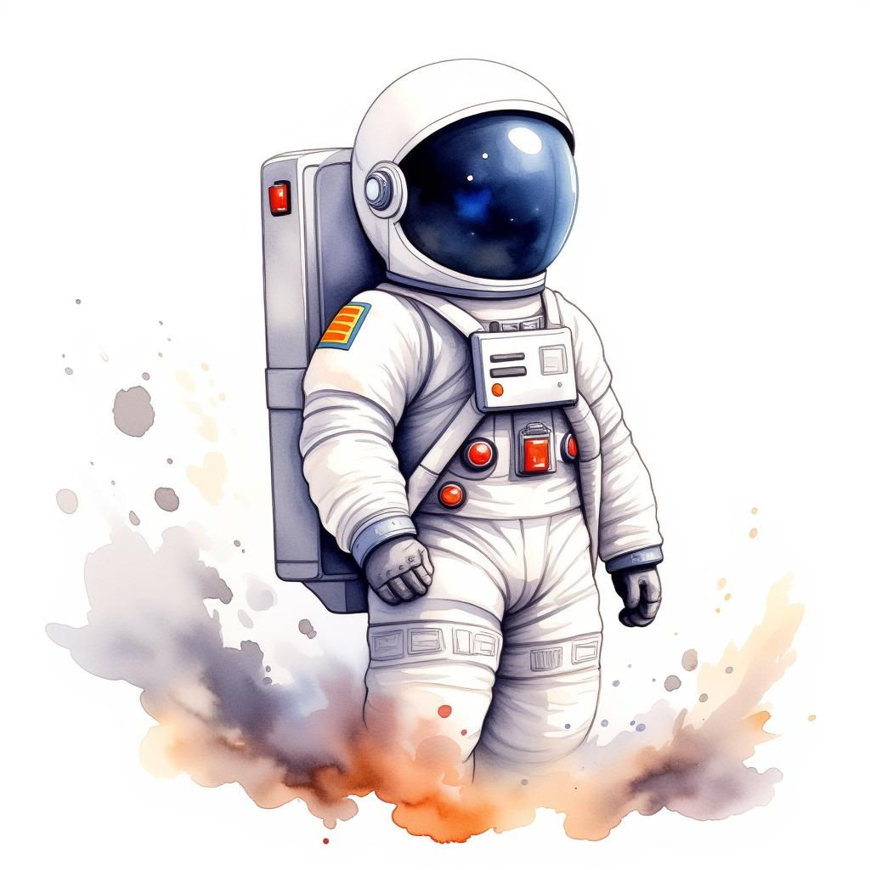
He puts on the spacesuit and the spacesuit starts to glow!
2

Slide 4

Mustafa starts to float up into the air in his spacesuit.
He waves bye-bye to his house as it gets tiny down below.
3

Slide 5
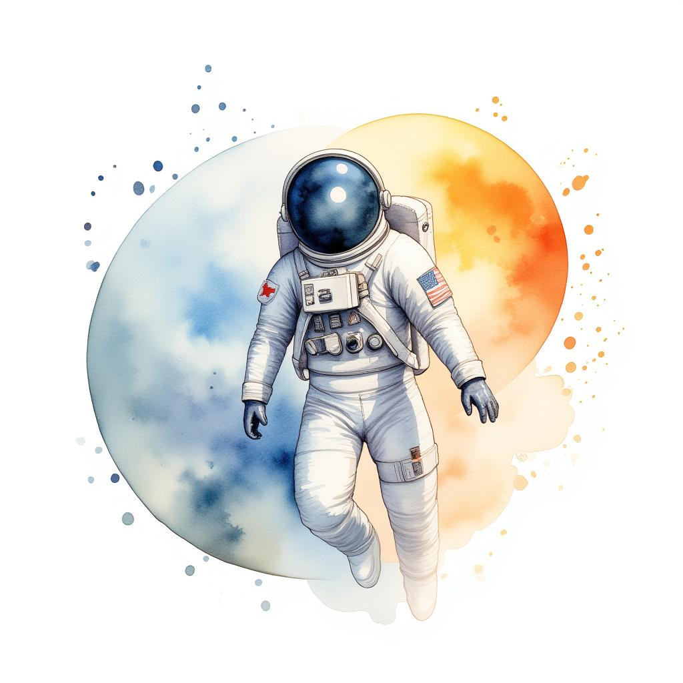
The stars look like tiny lights all around him.
His spacesuit flies fast past the moon and the sun.
4

Slide 6

Mustafa lands on Mars.
The landing makes a big crater in the Martian surface.
5

Slide 7
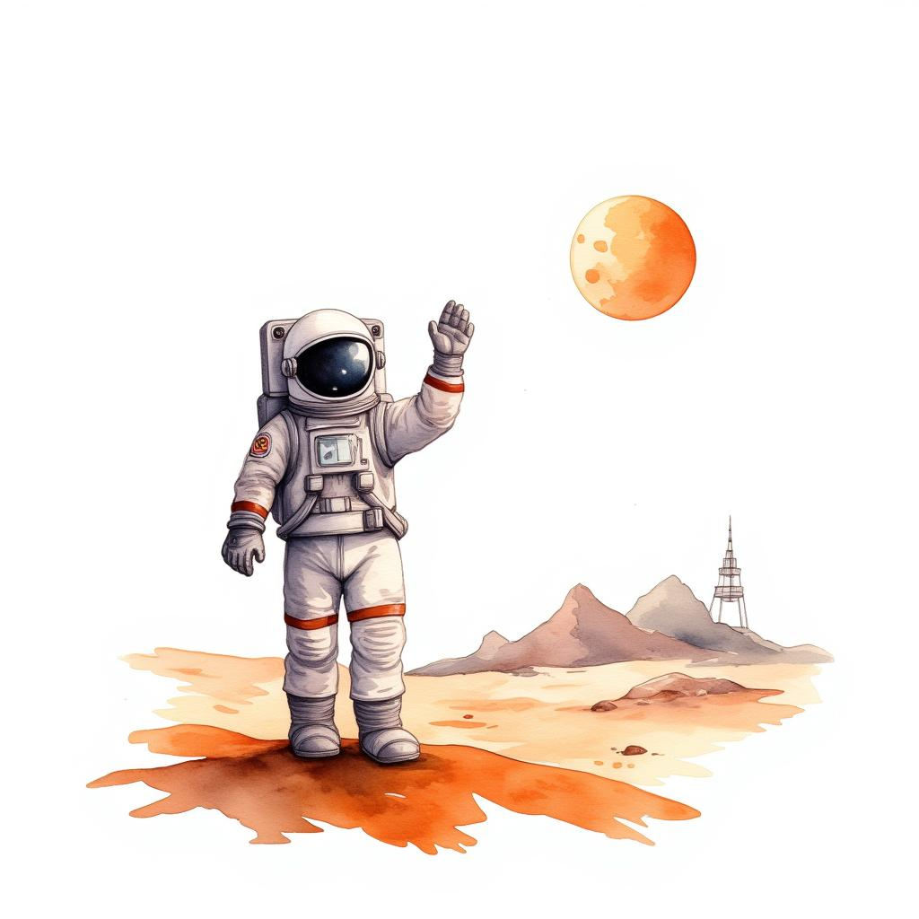
Mustafa explores Mars in his spacesuit.
He meets a Martian and waves hello to him.
6

Slide 8
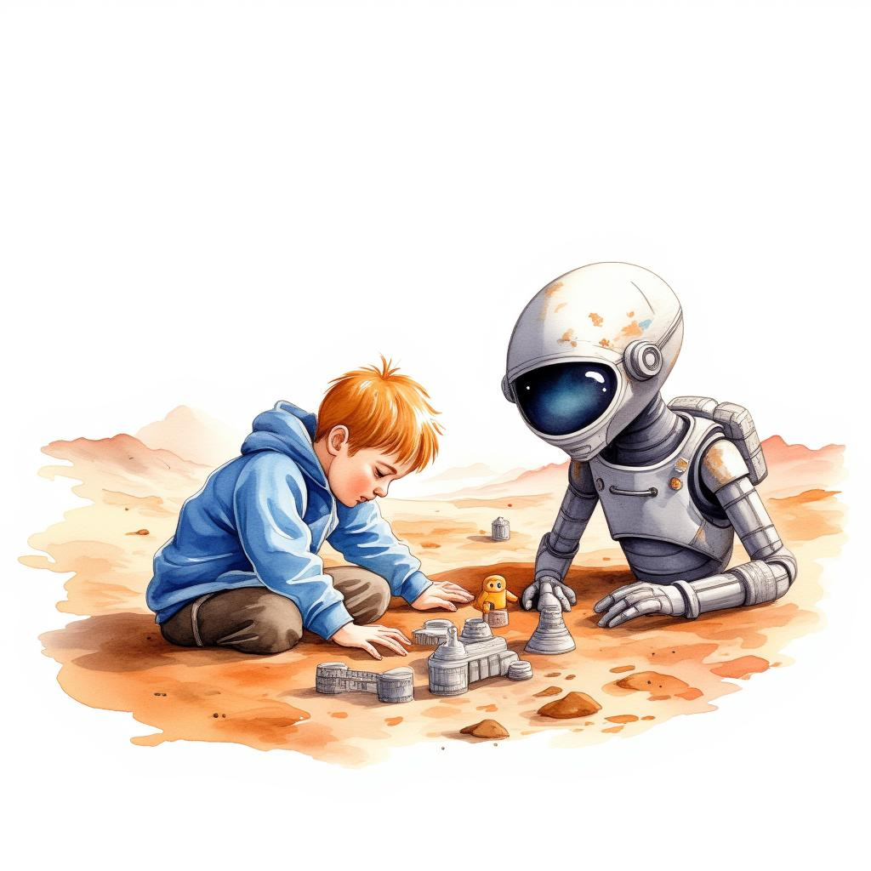
Mustafa and the Martian play with toys on Mars.
They have a great time together!
7

